Slide 1
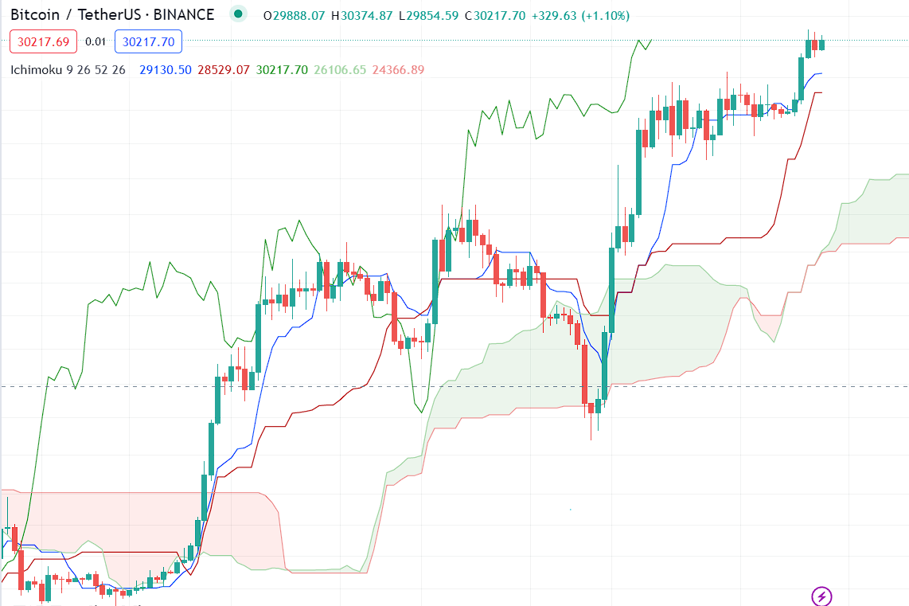
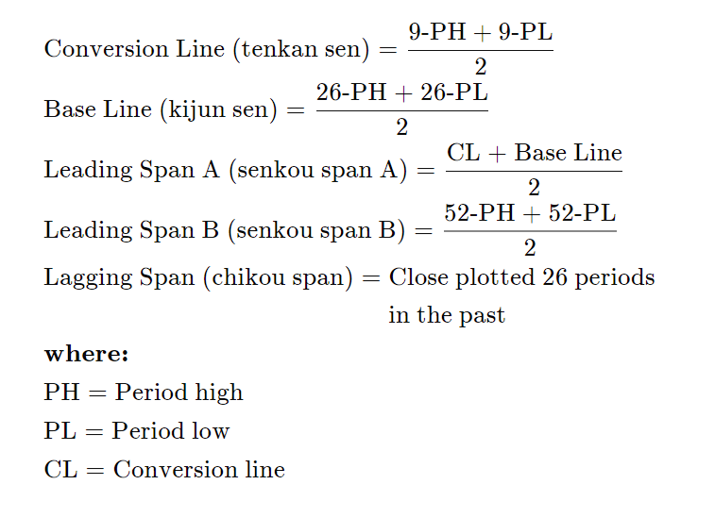
Ichimoku Cloud

Slide 2
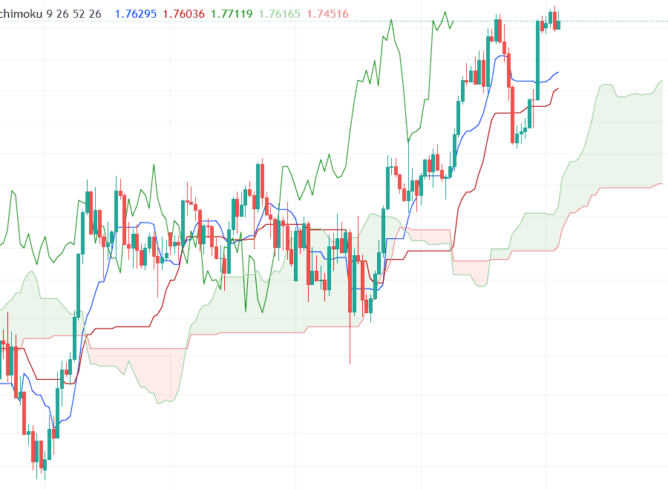
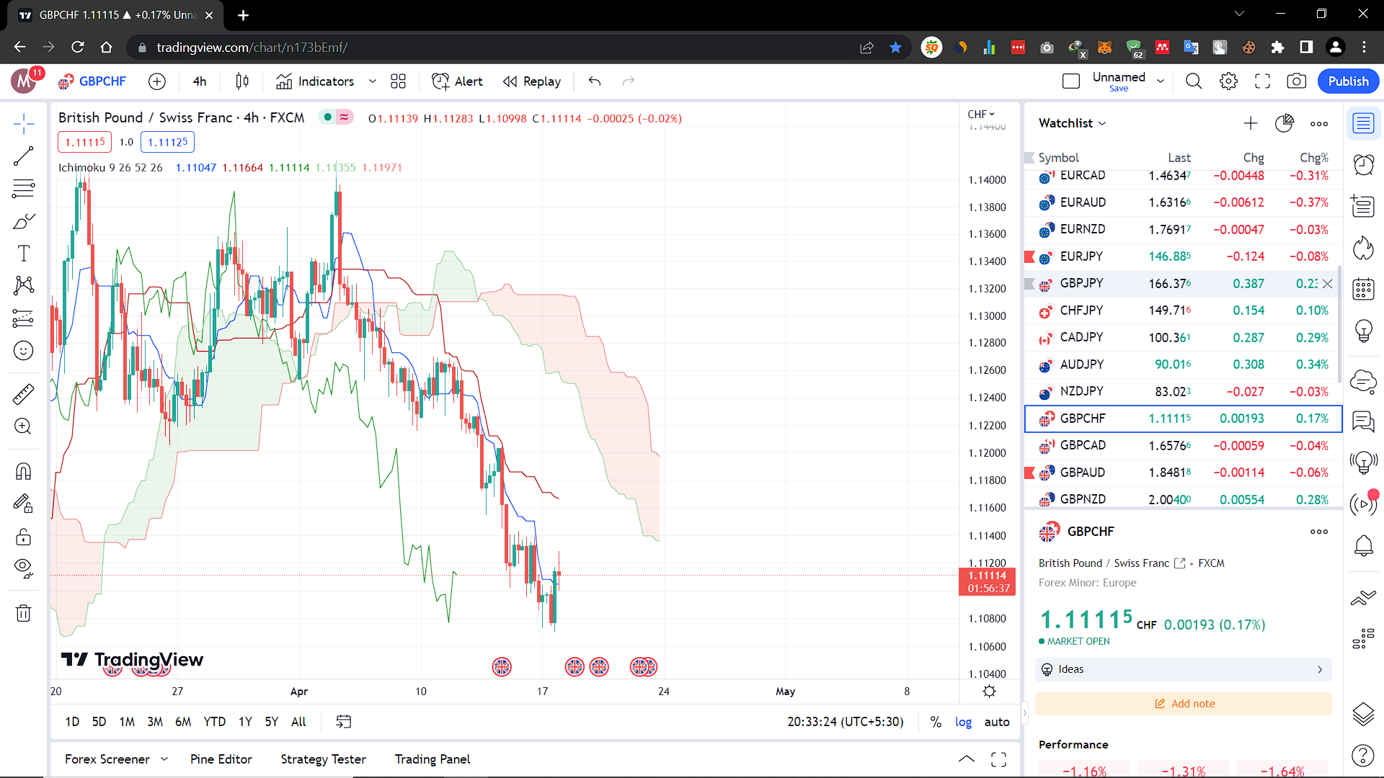
Ichimoku Trending Pairs
Up trend-
Thick green kumo
Tenkan and kijun should be out side the kumo cloud
Kijun and senku A - pointed upword
Tenken is above the kijun
Candles should be above the kijun
Lagging span – above the price
Down trend-
Thick red kumo
Tenkan and kijun should be out side the kumo cloud
Kijun and senku A - pointed downword
Tenken is below the kijun
Candles should be below the kijun
Lagging span – below the price

Slide 3
Trending Pairs in larger time frames ( 1D or 4H)
Trending Pairs in medium time frames ( 1h or 30M)
Enter the Trade with 3 conformations in 5M time frame
MACD Cross
Stochastic Cross
Candle stick Pattern ( head and shoulders , engulfing(inside,outside) breakout)
Price touching the outer Bollinger band
Trend line break out
Stop Loss – At the recent high/low in 5m timefreme

